Slide 1
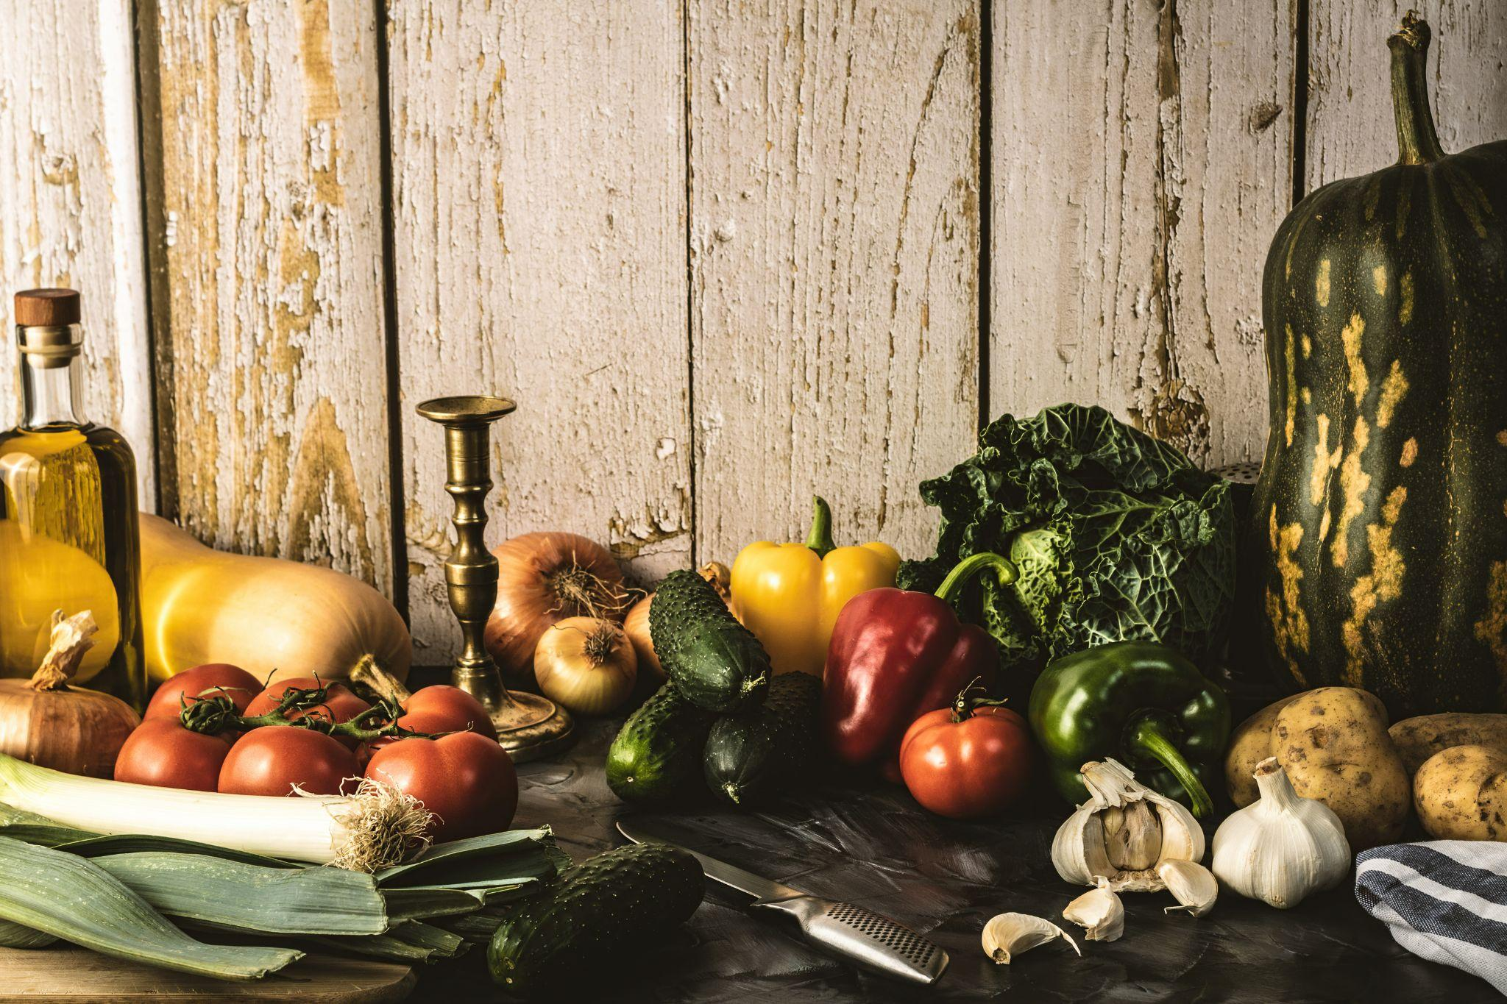
NourishNow
Project 1 - Coding Bootcamp
Diana Tran, Joshua Jones, Anu Philip Adeniyi

Slide 2
Elevator Pitch
NourishNow can help you plan your meals for the work week based on your dietary requirements.
Nourish Now will help you collate a shopping list and to locate the closest supermarket no matter where you are.

Slide 3
Concept
Concept
As a busy professional, I want to efficiently plan my meals with a set 5 day meal plan and have a shopping list that can be taken to the closest supermarket
Motivation
Time saving
Removes stress from meal planning
Supports better work life balance

Slide 4
Acceptance Criteria
GIVEN I need a set 5-day meal plan
WHEN I click on start button
THEN I am presented with a series of questions about my diet preferences
WHEN I click on the responses to the questions
THEN I am presented with the set 5-day meal plan
WHEN I am not happy with the meal plan, I have the option to click on the ‘Regenerate Meal Plan’ button
THEN the meal plan is regenerated for the week
WHEN I click on the ‘Create Shopping List’ button
THEN I am presented with a checklist of ingredients that I can tick off for ingredients that I have already
WHEN I click on the ‘Done’ button on the checklist
THEN the checklist is saved
WHEN I click on the ‘View Shopping List’
THEN I can view the saved shopping list
WHEN I click on the ‘Location’ button
THEN I am presented with a map of the closet Supermarket

Slide 5
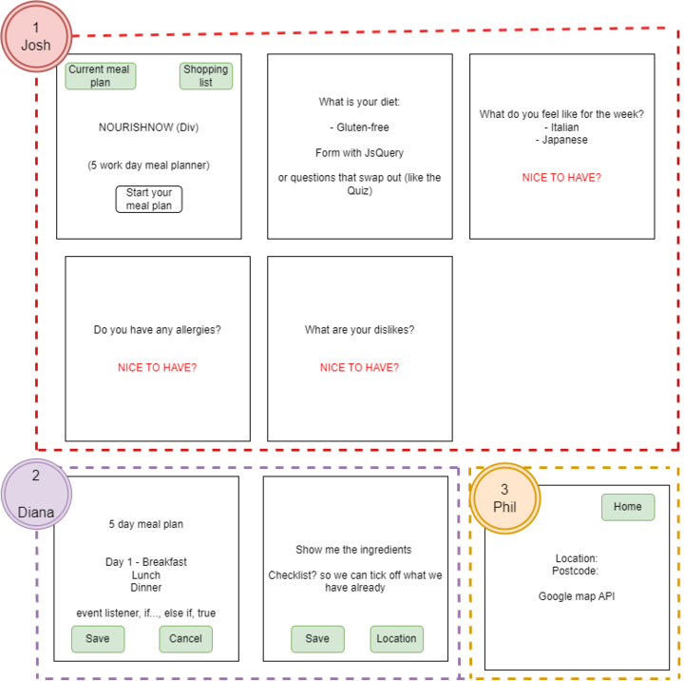
Process
Technology
HTML, CSS, JavaScript
Web and third party APIs
Process: GitHub,VSCode
Task Delegation
Home Page / Styling
Core functionality: Menu Generation
Location: Google APIs

Slide 6
Process
Challenges
All group members began project working on separate CSS, HTML and JS files
Created more work and bugs when merging files
Limited by what the API could provide e.g. no Gluten free options
API documentation was lacking or hard to follow
Successes
Expanded knowledge of CSS and built much more confidence in working with JavaScript
Overcame challenges with merging in GitHub and had the opportunity to experience first hand the reason and benefit of working with multiples branches
Produced a minimum viable product
Team work

Slide 7
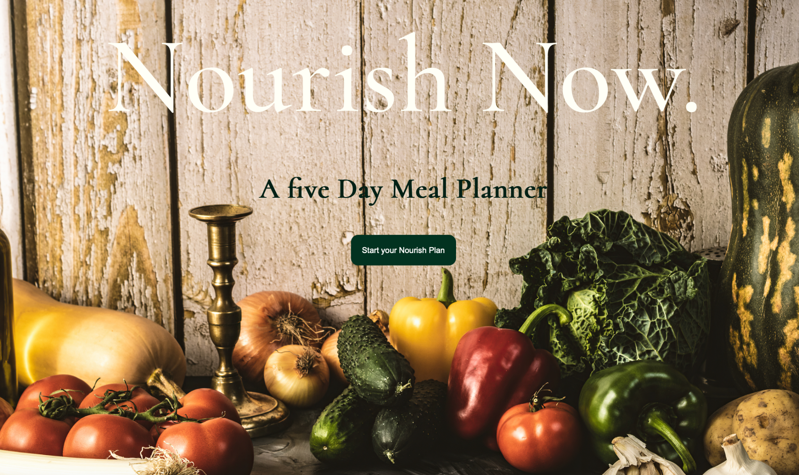
Demo
https://dtran44.github.io/NourishNow/

Slide 8
Directions for Future Development
Location
Search bar to alter request e.g. organic supermarket near me
Greater options for user meal preferences
Options based on types of Cuisines (eg. Italian, Japanese, American, etc)
Options based on user likes and dislikes (eg. dislikes olives, likes chocolate)
Options for user to nominate any allergies (eg. gluten, egg, peanuts, etc)
Breakfast category to be filtered down further for vegetarian & vegan options (currently the Breakfast category has meat options)
Delivery option for shopping list
Connect to UberEats/ Deliveroo API to organise ingredients delivery to home

Slide 9
Links
Deployed Web Application - https://dtran44.github.io/NourishNow/
GitHub repository - https://github.com/dtran44/NourishNow

